Slide 1
Business Use Case: Calendar API
Donald Cousar
Bellevue University
RESTful APIs

Slide 2
Why a Calendar API?
Cousar Insurance, LLC is an insurance agency that offers a myriad of insurance services. Our sales representatives are always expanding our client base through cold contacts, phone and mail leads, and referrals.
Our support staff has been tasked with assisting sales reps with managing appointments.
A Calendar API will allow sales reps to add and manage appointments from mobile devices, while their support representative counterpart manage appointments from the office from their work computer

Slide 3
What services will the API provide?
Get details of existing appointment
Add new appointments
Cancel appointments
Reschedule appointments
Check availability
Arrange auto-reminders to Sales reps
Robo-Dial customers with appointment reminder
Interact with Google Maps for easy GPS direction

Slide 4
Return on Investment (ROI)
Increased profits
Increased commissions
Better time management
With a support staff dedicated to managing appointments, sales reps will have a heavier appointment load, increasing the potential for signing new policies
Sales reps can now focus on closing more sales by utilizing time saved to personalizing solutions to meet the customer's needs.
Since appointments are tracked and managed by the office as well as by the sales reps, support staff can offer appointment swaps, based on sales reps physical locations, thus allowing sales reps to see more potential customers.

Slide 5
The API Design
7 Step Design Procedure

Slide 6
Step 1 API Info
Appointments
Add Appointment
Update appointment
Cancel appointment
Assign new rep
Swap appointment
Show my appointments
Customer Info
Get current policies
Get customer address
Map customer address
Show potential policies

Slide 7
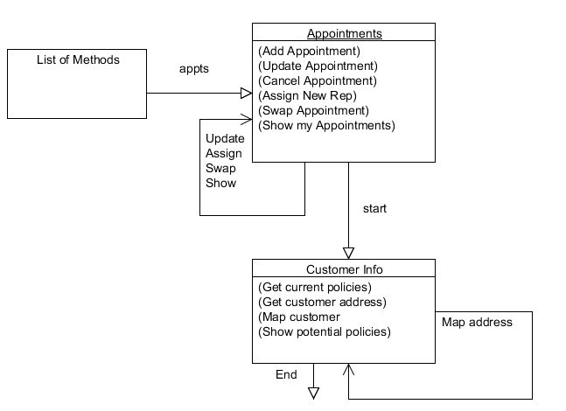
Step 2 State Diagram

Slide 8
Step 3 Reconcile Names
Choice: IANA-registered
Reason: There are relationships between service methods

Slide 9
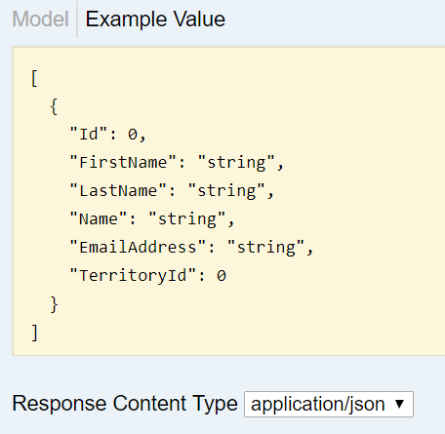
Step 4 Media Type
Choice: JSON
Reason: Mobile devices will connect to the API service.

Slide 10
Step 5 Profile
Choice: JSON Profile
Reason: It's human readable, easy, and customizable.

Slide 11
Step 6 Implementation
Language: Javascript (Node.JS)
Node packages
Express
BCryptJS
Bluebird
EJS
Mongoose
JSONWebToken
Morgan
Framework: MEAN Stack
Server Environment: Linux on AWS

Slide 12
Step 7 Publication
Publishing the URIs
APIs will utilize
Versioning
Standard Names
Secure HTTPS port
Development Environment
Staging Environment
Production Environment

Slide 13
References
Nair, Srijith. Nov 25, 2015. JSON Profile. Retrieved from: https://www.axiomatics.com/blog/using-json-and-rest-profiles-for-external-authorization/
Richardson, L., Amudsen, M., & Ruby, S. (2015). RESTful Web APIs. Sebastopol, CA: OReilly Media. pp. 157–197.

